Slide 1
Passing
By: Lauren Dunn &
Lorene Russell

Slide 2
Passing (Definitions)
The concept of "passing" rests on the one-drop rule and on folk beliefs about race and miscegenation, not on biological or historical fact (Davis).
“Passing, as commonly understood, involves people who are legally defined as black fraudulently (sic) adopting white identities and inhabiting spaces marked out for white people: that is, in passing, people have crossed a ‘colour line’, a racial boundary, to assume a different racial identity” (Pile).
“To pass as white requires more than simply the cultural resources to assume a white identity, it also requires a skin colour that permits an individual to look visibly white to others” (Pile).
“In this view, passing demonstrates that identities and bodies are mutable, indecipherable, mobile and changeable” (Pile).
Davis, F. James. "Who Is Black? One Nation's Definition." PBS. PBS, n.d. Web. 20 June 2013.
Pile, Steve. "Skin, Race And Space: The Clash Of Bodily Schemas In Frantz Fanon’S Black Skins, White Masks And Nella Larsen’S Passing." Cultural Geographies 18.1 (2011): 25-41. Academic Search Premier. Web. 24 June 2013.

Slide 3
Circumstances for Passing
For passing to be possible, certain basic assumptions have to be made:
First, space has to be segregated and bounded, with homogeneity of the population within the boundaries.
Second, these boundaries have to be porous.
Third, there have to be ways to fool the border guards (whatever the form that this ‘fooling’ or ‘guarding’ takes).
“It is the ability to fool the ‘border guards’ of identity, and to call into question the nature of identity, whether founded culturally or corporeally, that gives passing its radical or transgressive political edge” (Pile).
Pile, Steve. "Skin, Race And Space: The Clash Of Bodily Schemas In Frantz Fanon’S Black Skins, White Masks And Nella Larsen’S Passing." Cultural Geographies 18.1 (2011): 25-41. Academic Search Premier. Web. 24 June 2013.

Slide 4
“The Line”
Passing is a spatial practice. Passing also means crossing a line, marked in space (Pile).
“They involve: some form of disguise or pretense; inhabiting a space that is, in some way, exclusive; and, consequently, crossing a cultural and spatial boundary, which is policed – yet not well enough” (Pile).
Adam Meyer questions what the “color line” even means. Meyer points out that if there is a line that separates race into black and white, mixed-race people have defied these race categories and can be placed in either one. He, also, suggests that race is based on appearance, but appearance can be deceptive in relation to mixed people (Meyer).
Meyer, Adam. “Not Entirely Strange, But not Entirely Friendly Either: Images of Jews in African American Passing Novels Through the Harlem Renaissance.” African American Review, Volume 38, Number 3 (2004): 441-450. Academic Search Premiere. Web. 12 June 2013.
Pile, Steve. "Skin, Race And Space: The Clash Of Bodily Schemas In Frantz Fanon’S Black Skins, White Masks And Nella Larsen’S Passing." Cultural Geographies 18.1 (2011): 25-41. Academic Search Premier. Web. 24 June 2013.

Slide 5
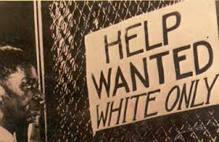
Motivations
The motivation for passing, in this context, is to escape racial oppression or discrimination and also to claim the privileges and status of the dominant race (Pile).
For some, passing is continuous, meaning that these individuals would disassociate themselves from their black community and past and would reinvent themselves in order to escape any stigma associated with being black (Khanna and Johnson).
Discontinuous passing was perhaps more commonly used. Discontinuous involved “trips across the color line for practicality, amusement, and/or revenge” (Khanna and Johnson 382).
Khanna, Nikki, and Cathryn Johnson. "Passing As Black: Racial Identity Work Among Biracial Americans." Social Psychology Quarterly 73.4 (2010): 380-397. Academic Search Premier. Web. 12 June 2013.
Pile, Steve. "Skin, Race And Space: The Clash Of Bodily Schemas In Frantz Fanon’S Black Skins, White Masks And Nella Larsen’S Passing." Cultural Geographies 18.1 (2011): 25-41. Academic Search Premier. Web. 24 June 2013.

Slide 6
One Drop Rule
Purpose: Who is Black?
A single drop of “black blood” makes a person a black.
Reason: A tool used for segregation
Racial mixed persons were assigned the status of the subordinate group.
Where: America
The rule is unique in that it is found only in the United States and not in any other nation in the world.
http://www.pbs.org/wgbh/pages/frontline/shows/jefferson/mixed/onedrop.html
Davis, F. James. "Who Is Black? One Nation's Definition." PBS. PBS, n.d. Web. 20 June 2013.

Slide 7
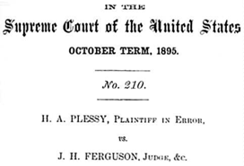
Plessy V. Ferguson
In June 1892, Homer A. Plessy purchased a one-way ticket aboard the East Louisiana Railway, departing New Orleans and bound for Covington, Louisiana.
Plessy was arrested for violating the Louisiana Separate Car Act, his case was argued before the U. S. Supreme Court, and his conviction was upheld in Plessy v. Ferguson (1896) under the doctrine of ‘‘separate but equal.’’
The Plessy case is infamous for extending constitutional sanction to Jim Crow segregation laws.
By appearance, Homer Plessy could have passed for a white man.
In the language of the Court, Plessy’s ‘‘one-eighth African blood’’ was ‘‘not discernible in him’’
If he had not informed the train conductor of his African American race, he would not have been questioned, and would have gone on to pass as a white man.
Because Plessy could pass for white, he was chosen to bring the test case, which had been arranged by prominent leaders from New Orleans’ Creole community as part of a planned challenge to the constitutionality of the act.
Golub, Mark. "Plessy As “Passing”: Judicial Responses To Ambiguously Raced Bodies In Plessy V. Ferguson." Law & Society Review 39.3 (2005): 563-600. Academic Search Premier. Web. 24 June 2013.

Slide 8
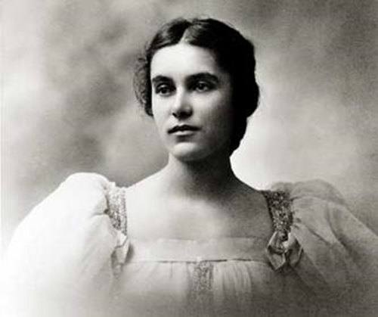
Anita Florence Hemmings Vassar
“When Anita Florence Hemmings applied to Vassar in 1893, there was nothing in her records to indicate that she would be any different from the 103 other girls who were entering the class of 1897. But by August 1897, the world as well as the college had discovered her secret: Anita Hemmings was Vassar’s first black graduate — more than 40 years before the college opened its doors to African Americans.” (Olivia Mancini)
Mancini, Olivia. "Passing as White: Anita Hemmings 1897." Vassar: The Alumnae/i Quarterly Winter 2001 Volume 98 Issue 1: n. pag. Web. 17 June 2013.

Slide 9
Color Line Personal Account
Color Line is an article of a personal account of a black boy who discovers his family’s white heritage. Due to the culture that this boy grew up in, it was dangerous for him and his family to claim heritage of a white man.
“My parents kept my grandfather's portrait hidden because in 1960s Mississippi, with all its racial paranoia, displaying the picture in our living room would have been risky, if not impossible. Severe social consequences awaited any black person claiming close kinship with a white person. So the picture stayed hidden, part of my mother's past, and my own—something I knew about but didn't yet feel free to explore.”
“In 21st-century America, my family would be described as multiracial. But in the world I grew up in—the American South of the 1950s and 1960s, where the idea of race and identity determined who you were and your place in the world—you were either black or white. We were first colored, later Negroes, and still later black. Claiming mixed status meant you were either trying to be white (implying that black was inferior) or trying to pass for white (a dangerous business few spoke of openly), and doing so carried the risk of being labeled a racial traitor. Consequently, my identity was shaped by the racial boundaries of the American South as well as the double consciousness that W. E. B. Du Bois speaks of in The Souls of Black Folk. I always felt that duality: "an American, a Negro; two souls, two thoughts, two unreconciled strivings; two warring ideals in one dark body, whose dogged strength alone keeps it from being torn asunder."
Eubanks, W. Ralph. "Color Lines. (Cover Story)." American Scholar 82.2 (2013): 20-28. Academic Search Premier. Web. 24 June 2013.

Slide 10
White by Day…Negro By Night Personal Account
Thousands Live Jekyll-Hyde Existence to Hold White Jobs
Biracial individuals who can “pass” for white do so in order to obtain jobs that are frequently held by the white population. These individuals live in fear of their secret being known.
Belief Negroes can Identify Passing Negros Proves Myth
“According to Negros who have passed, the myth that it is easy for another Negro to recognize a light-skinned Negro who is passing is exactly that—a myth “ (82).
Big Test is Keeping Silent, Emotionless
“The Negro who passes for white must steel himself to suffer inwardly and to show no sign of emotion as his white co-workers start spreading derogatory stereotypes about Negroes” (83).
“Hearing anti-Negro joke while in white office, Negro girl (center) is not amused. Model is Carletta Johnson who has passed but now lives happily as Negro.”
"White By Day... Negro By Night." Ebony 31.1 (1975): 80. MasterFILE Premier. Web. 12 June 2013.

Slide 11
Timeline
1776 - A passage condemning the slave trade is removed from the Declaration of Independence due to pressure from the southern colonies.
1787 - The U.S. Constitution is ratified. It provides for the continuation of the slave trade for another 20 years and required states to aid slaveholders in the recovery of fugitive slaves.
1793 - Congress passes the first Fugitive Slave Act, which makes it a crime to harbor an escaped slave.
1807 - Congress bans the importation of slaves into the U.S. The law will be largely ignored in the South.
1831-1861 - Approximately 75,000 slaves escape to the North and freedom using the Underground Railroad, a system in which free African American and white "conductors," abolitionists, and sympathizers guide, help, and shelter the escapees.
1850 - Congress passes another Fugitive Slave Act, which mandates government support for the capture of escaped slaves, and spurs widespread protest in the North.
1857 - In the Dred Scott case, the Supreme Court decides that African Americans are not citizens of the U.S., and that Congress has no power to restrict slavery in any federal territory. This meant that a slave who made it to a free state would still be considered a slave.
1861 - The Civil War begins. The war, fought over the issue of slavery, will rage for another four years. The Union's victory will mean the end of slavery in the U.S.

Slide 12
Timeline
1863 - President Abraham Lincoln's Emancipation Proclamation legally frees all slaves in the Confederacy.
1865 - Congress passes the Thirteenth Amendment, outlawing slavery, and establishes the Freedmen's Bureau to assist former slaves. This is the beginning of the Reconstruction era.
1866 - Congress passes the Civil Rights Act, which confers citizenship on African Americans and grants them equal rights with whites.
1881 - Tennessee passes the first of the "Jim Crow" segregation laws, segregating state railroads. Other Southern states pass similar laws over the next 15 years.
1896 - In Plessy v. Ferguson, the U.S. Supreme Court rules that segregated, or "separate but equal," public facilities for whites and black African-American are legal. The ruling stands until 1954.
1954 - In Brown v. Board of Education of Topeka, Kansas, the Supreme Court rules unanimously against school segregation, overturning its 1896 decision in Plessy v. Ferguson.
1972 - The Equal Employment Opportunity Act is passed, prohibiting job discrimination on the basis of, among other things, race, and laying the groundwork for affirmative action.
1990 - The U.S. Census reveals an increase in the African American population to 12 percent of the total U.S. population, with over 50 percent of all African Americans still residing in southern states.
1991 - The Civil Rights Act of 1991 makes it easier for employees to sue their employers for job discrimination.
http://www.pbs.org/wnet/aaworld/timeline/early_01.html

Slide 13
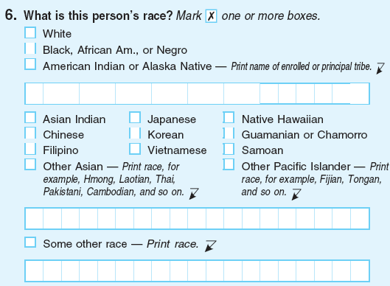
Passing Today
According to Nikki Khanna and Cathryn Johnson, passing is still happening today, however, it’s going in a different direction.
Through interviews, Khanna and Johnson, identified five strategies commonly used with their participants: verbal identification/disidentification, selective disclosure, manipulation of phenotype, highlighting/downplaying cultural symbols, and selective association.
Though reasons and strategies for individuals passing may vary in some degree, the final reason for motivation in identifying oneself with a certain race group is for acceptance.
Khanna, Nikki, and Cathryn Johnson. "Passing As Black: Racial Identity Work Among Biracial Americans." Social Psychology Quarterly 73.4 (2010): 380-397. Academic Search Premier. Web. 12 June 2013.

Slide 14
Racial Passing Literature
In the literature of late nineteenth- and early twentieth-century America, black characters who pass for white embody a paradox. By virtue of the "one drop" rule that long governed the nation's race relations, they are legally black. Yet the color of their skin makes them visibly-and therefore socially-white.
Many African American novels deal with a certain common theme: blacks attempting to pass for white in order to attain a better social position. In order to pass for a different race, there must be expectations set for each of the races.

Slide 15
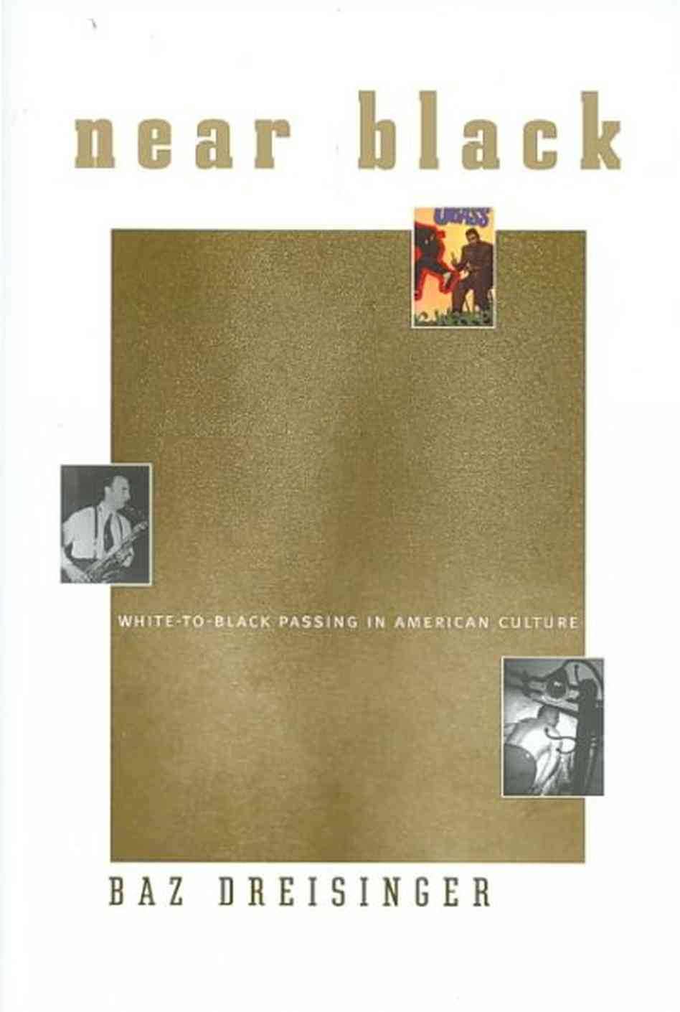
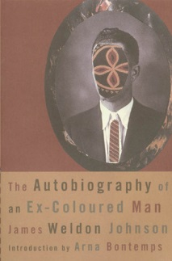
Literature
In Near Black, Baz Dreisinger explores "reverse racial passing" by looking at short stories, novels, films, autobiographies, and pop-culture discourse that depict whites passing for black.
The Autobiography of an Ex-Coloured Man tells the story of a biracial man who, because of his light color skin, is able to pass for white. This novel closely examines race in America.

Slide 16
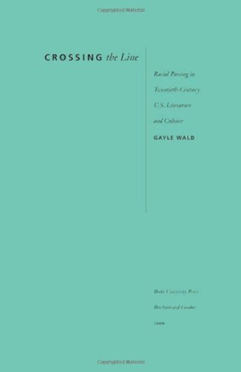
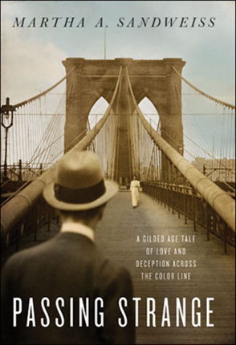
Literature
In Gayle Wald’s novel, CROSSING the Line, she uses cultural narratives of passing to express a variety of needs, interests, and desires. She makes the argument that race defines, but also fails to represent identity.
“In Passing Strange, noted historian Martha A. Sandweiss tells the dramatic, distinctively American tale of a family built along the fault lines of celebrity, class, and race- a story that spans the long century from Civil War to civil rights.”
"Passing Strange: A Gilded Age Tale of Love and Deception Across the Color Line [Bargain Price] [Paperback]." Amazon.com: Passing Strange: A Gilded Age Tale of Love and Deception Across the Color Line: Martha A. Sandweiss: Books. N.p., n.d. Web. 27 June 2013.

Slide 17
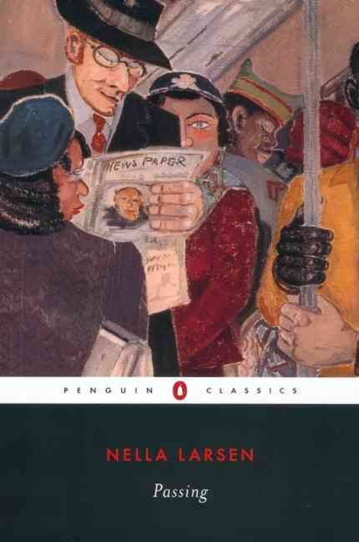
Literature
Passing, is a short, fictional work by Harlem Renaissance writer, Nella Larsen. Published in 1929, the narrative tells of two biracial women who “pass” for white. Irene Redfield lives as a black woman and occasionally passes to gain societal privileges, while Clare Kendy passes as apart of the white society all the time, and is married to a racist white man.

